Slide 2
Objectives
Understand what robots are
Describe the characteristics of robots
Understand the roles that robots perform along with their advantages and disadvantages
Understand the roles of robots in the following areas:
Industry
Transport
Agriculture
Medicine
Domestic
Entertainment

Slide 3
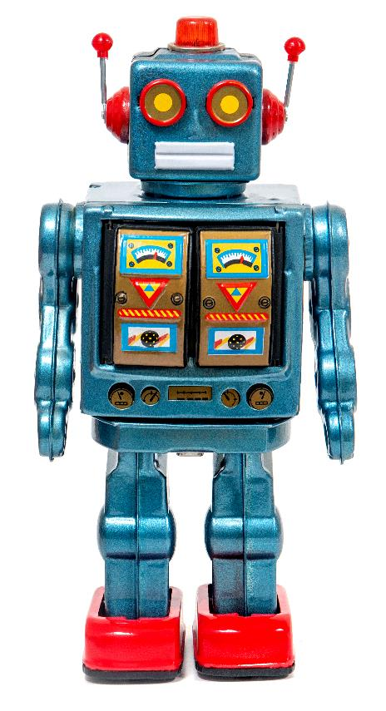
Starter
Robots have many uses today
Name at least three different areas where robots are used

Slide 4
Starter
Name at least three different areas where robots are used
Industry – e.g. manufacturing of food and products
Transport – e.g. self driving trains and cars
Agriculture – e.g. sowing, fertilising, harvest and picking
Medicine – e.g. testing and surgery
Domestic – e.g. robot vacuum cleaner and lawn mowers
Entertainment – e.g. toys, robot servers

Slide 5
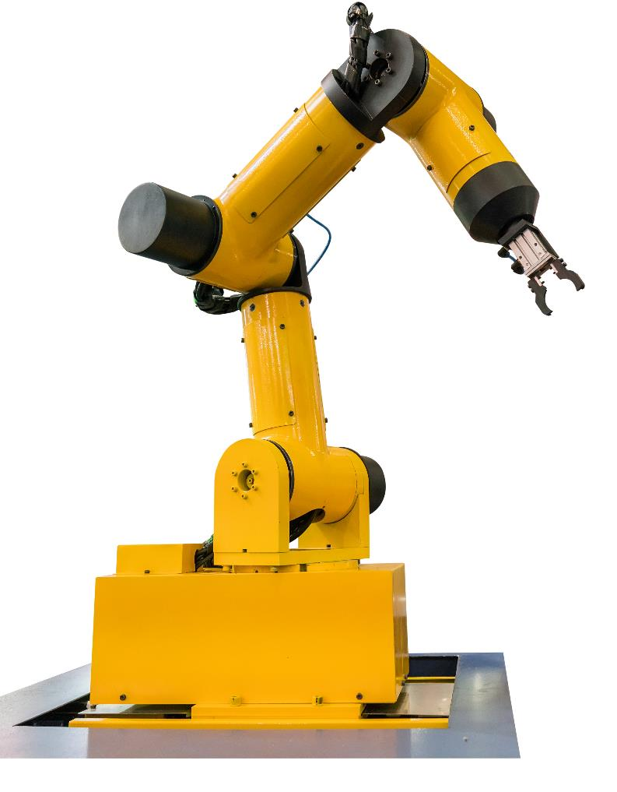

Robotics
Robotics is a branch of Computer Science that incorporates the design, construction and operation of robots
What are the characteristics of a robot?

Slide 6
Characteristics
Robots have the following characteristics:
They have a mechanical structure or framework
They have electrical components, such as sensors, microprocessors and actuators
They are programmable

Slide 7
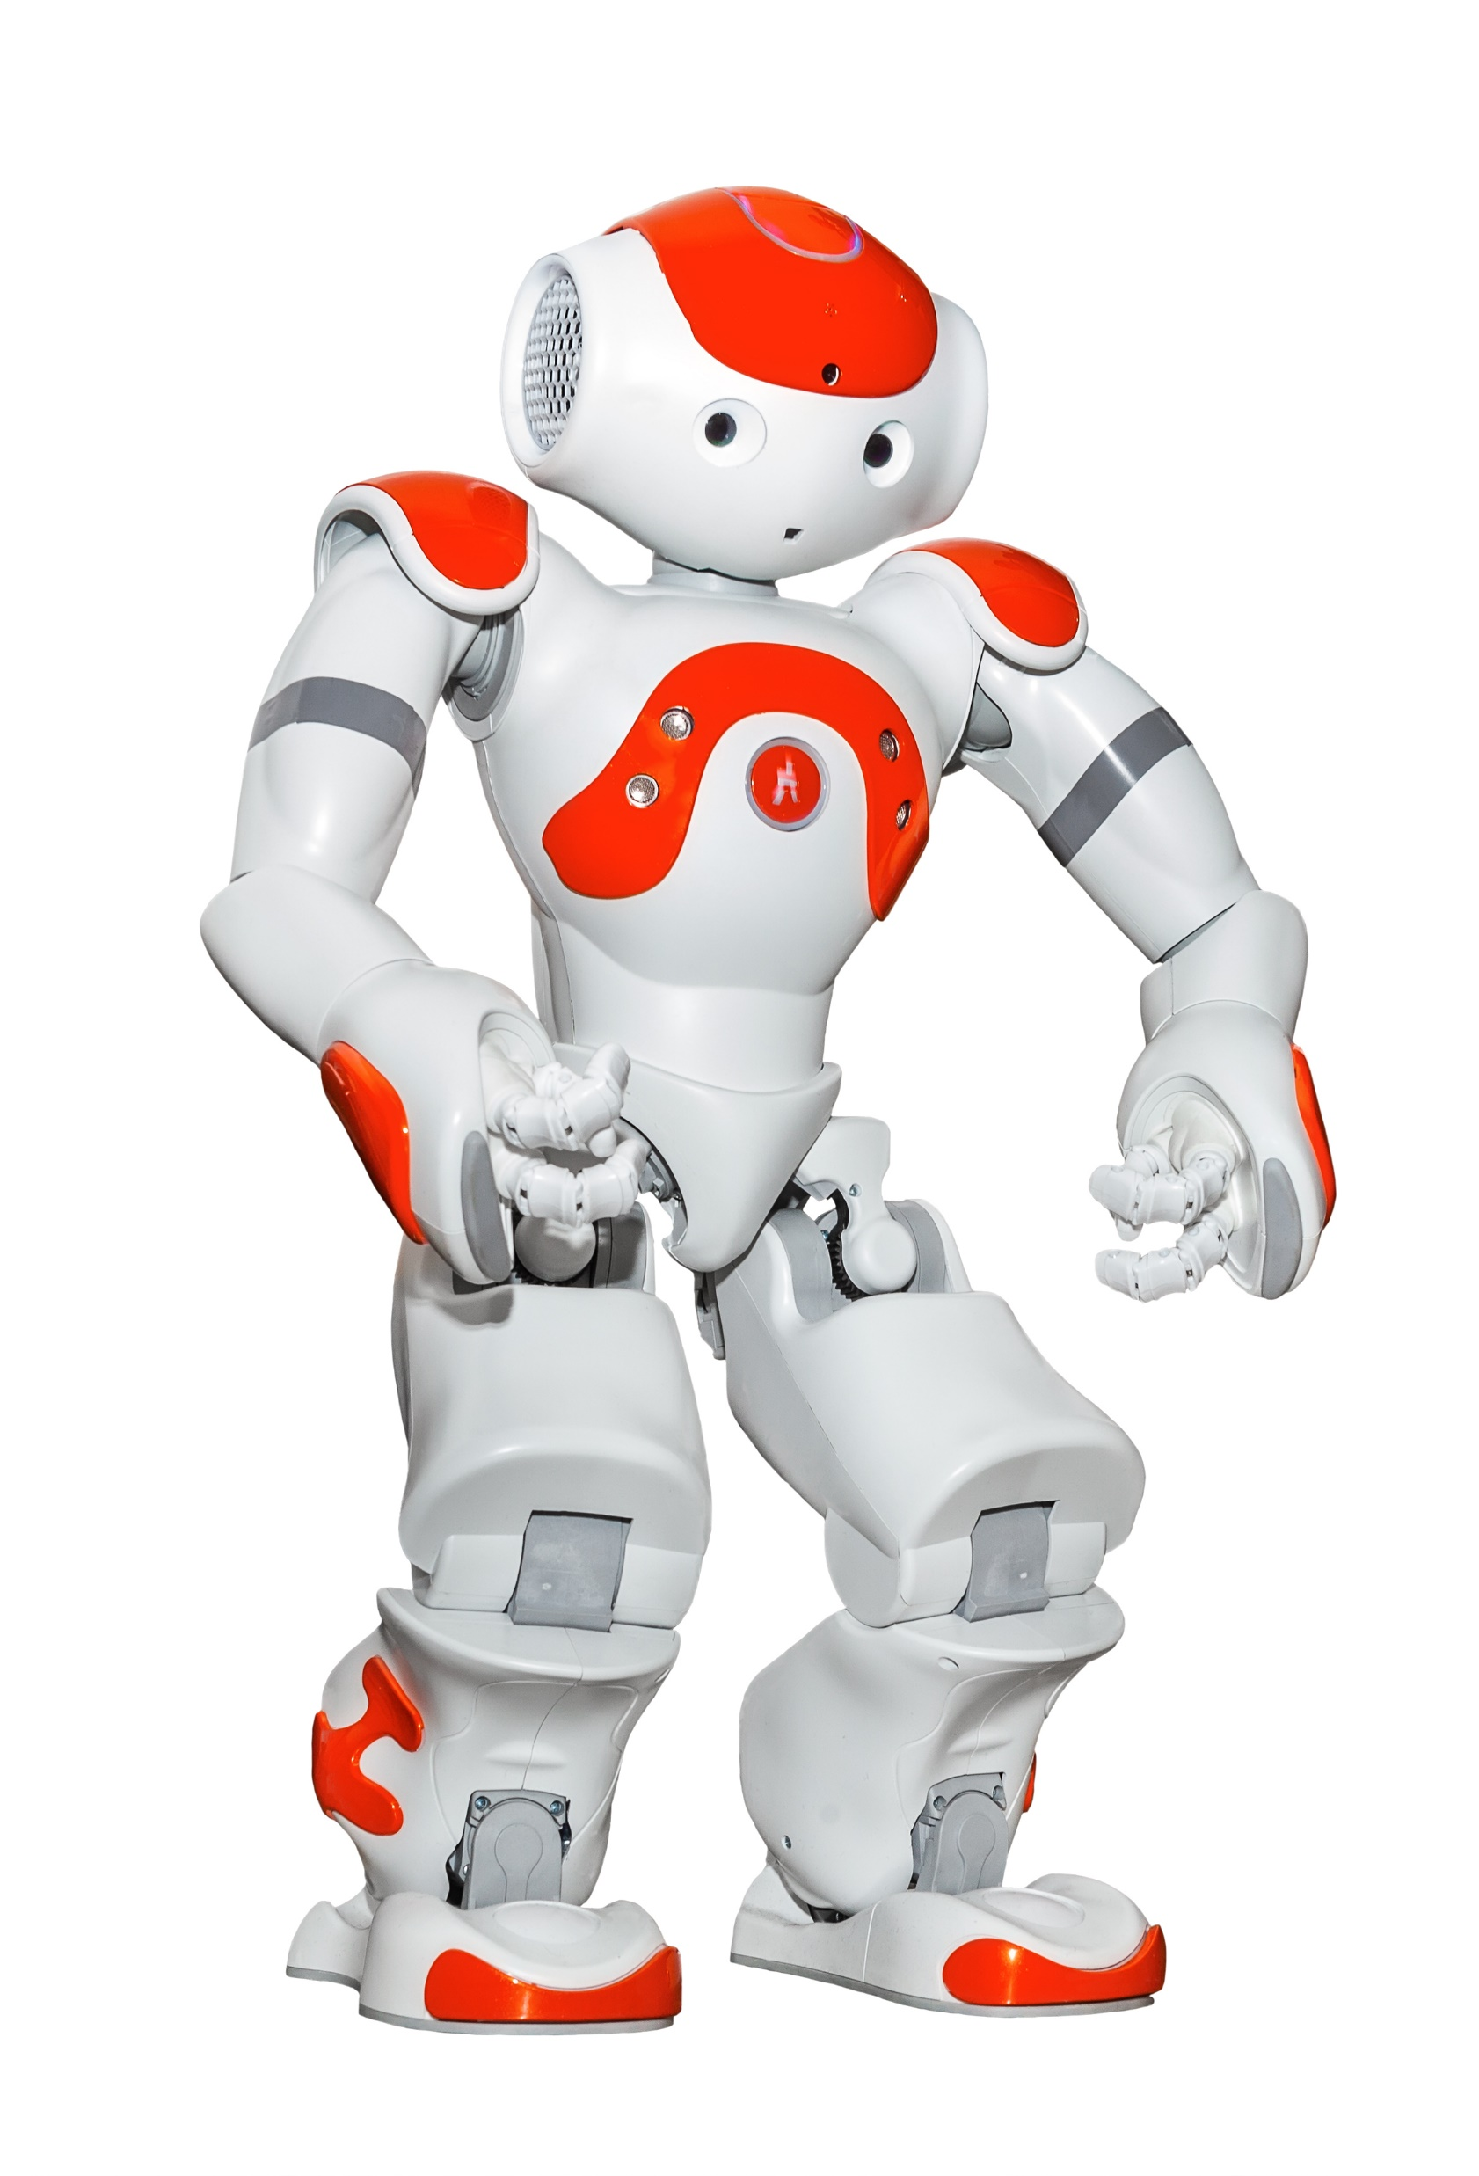
Electrical components
Identify the electrical components used in this robot
Remember, some of them are visible and some aren’t

Slide 8
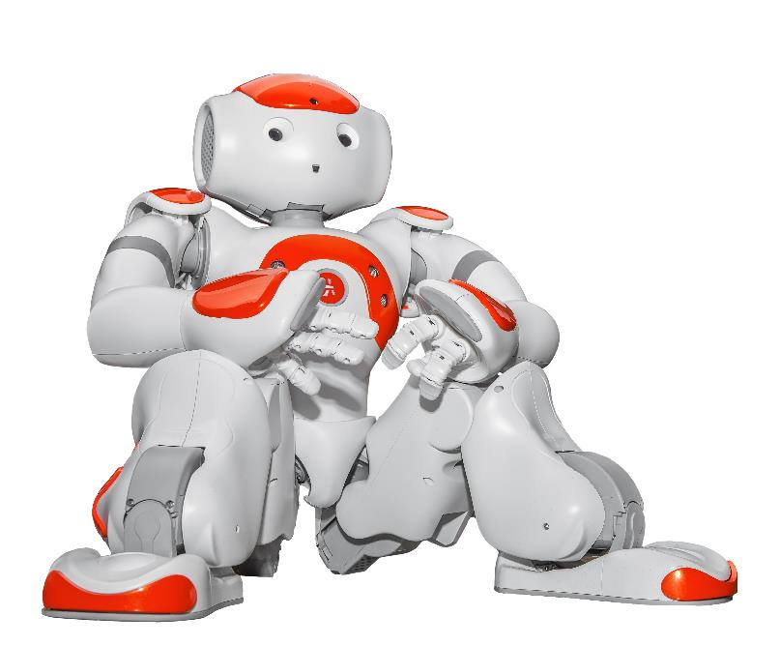
Electrical components
Sensors
Two HD cameras
10 tactile sensors (head x3, chest x1, hand x2, foot x4)
Four microphones
Microprocessors
At least one will be required for processing instructions
Actuators
13 actuators control the head, arms, hands, legs and feet

Slide 9
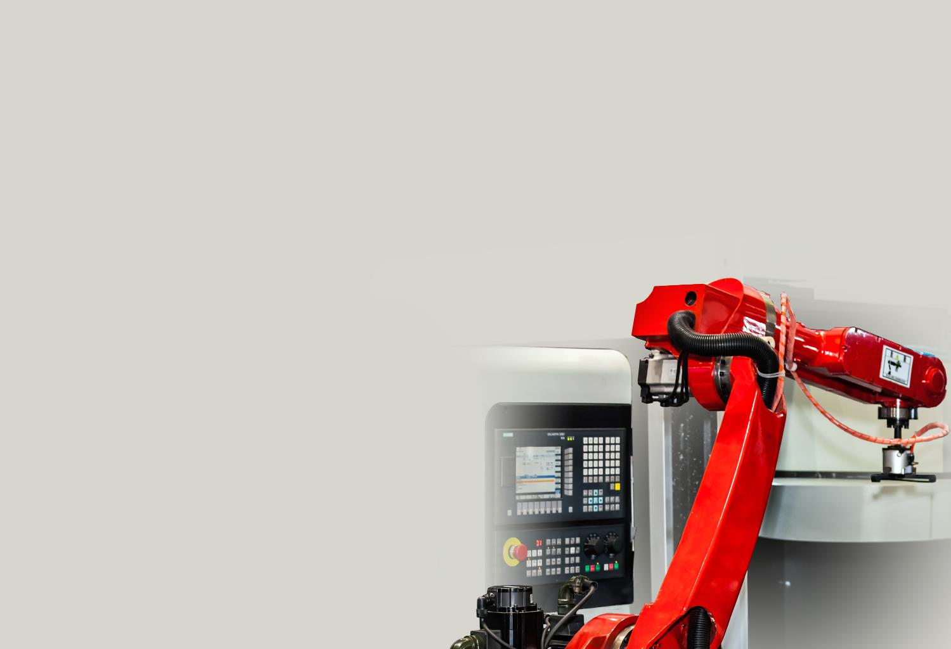

Programmable
Robots are programmable
They may have a program that cannot change stored in ROM
Or they may be programmable for different purposes
The photo shows a CNC machine (Computer Numerical Control)
It is programmed using the buttons on the left
Some robots are programmed using text languages or using 3D environments

Slide 10
Worksheet 2
Complete Task 1 and Task 2 on Worksheet 2

Slide 11
Roles robots perform
One area where robots are used is industry
Work with a partner to consider:
One other area where robots work
A specific example of where a robot is used in this area

Slide 12
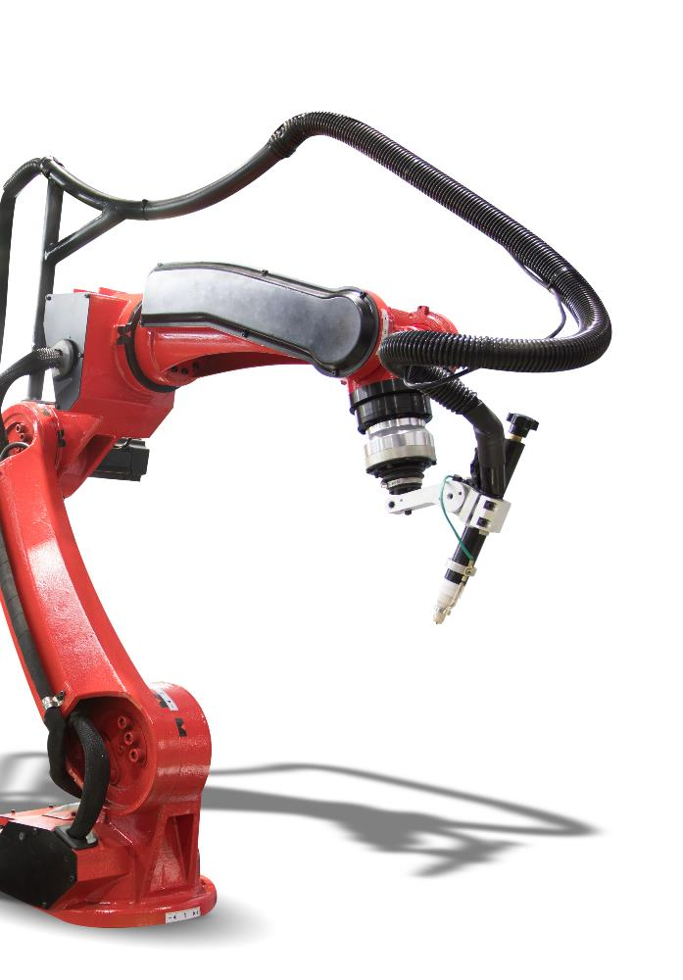
Industry
Robots have many uses in industry including making and packing products
Industrial robots are used in car manufacture
They are more accurate
They are able to work without breaks
They can work in hazardous environments

Slide 13
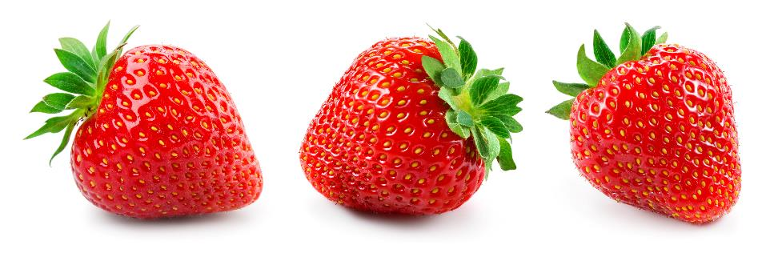
Agriculture
Robots have many uses in agriculture
They may be used in sowing seeds, applying fertiliser or harvesting crops
GPS helps in navigation of tractors
Drones may be used to survey fields
Work in a pair to consider how a strawberry picking robot could work

Slide 14

Medicine
Robots are increasingly being used in medicine
Robotic arms are able to make incisions, remove tissue and stitch patients
Where they are currently used they are monitored by a human surgeon
Robots are used as they are more accurate and don’t have slight tremors like humans do

Slide 15
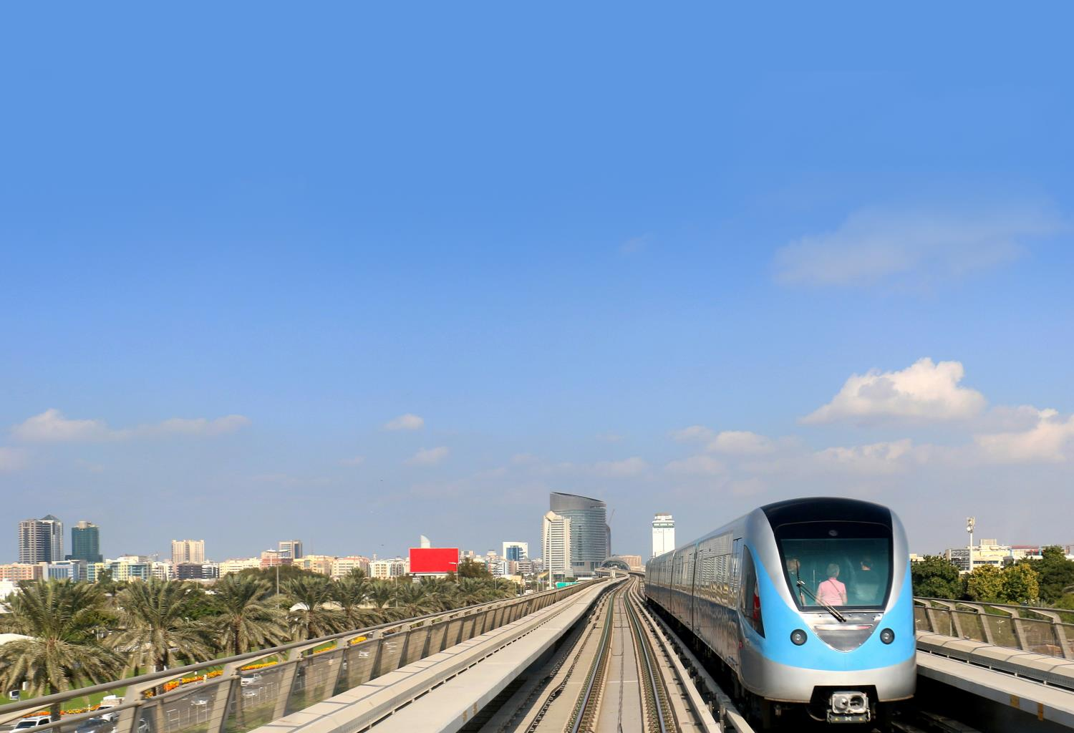
Automated transport systems
Transport systems are automated to the degree that they can be considered as robots
Planes have sophisticated auto-pilot systems that are able to take-off, fly and land the plane
Many trains, especially light rail networks, (at airports or Docklands Light Railway) do not have drivers
Self-driving cars are currently in development and already available in some cities

Slide 16
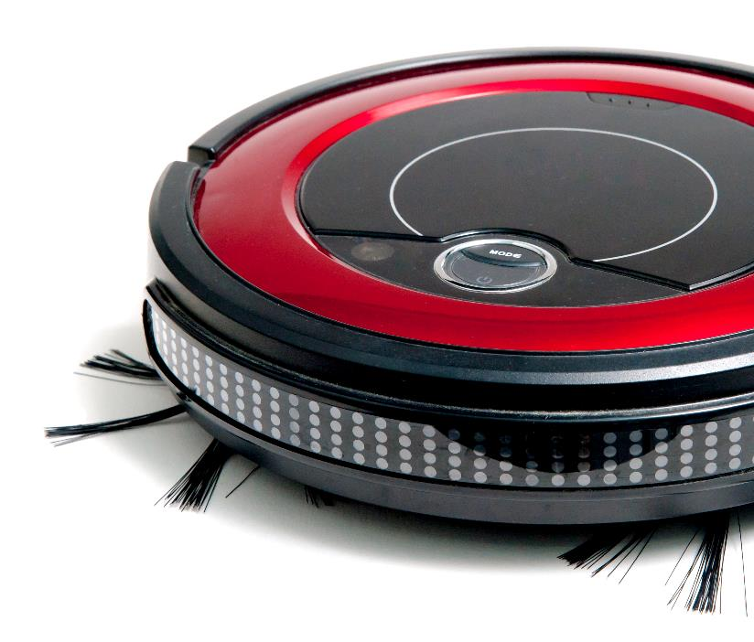
Domestic robots
Domestic robots are able to carry out many household tasks
Robot vacuum cleaners may be programmed to clean certain areas of a house
Robot lawn mowers are able to cut allocated areas of lawn in a garden

Slide 17
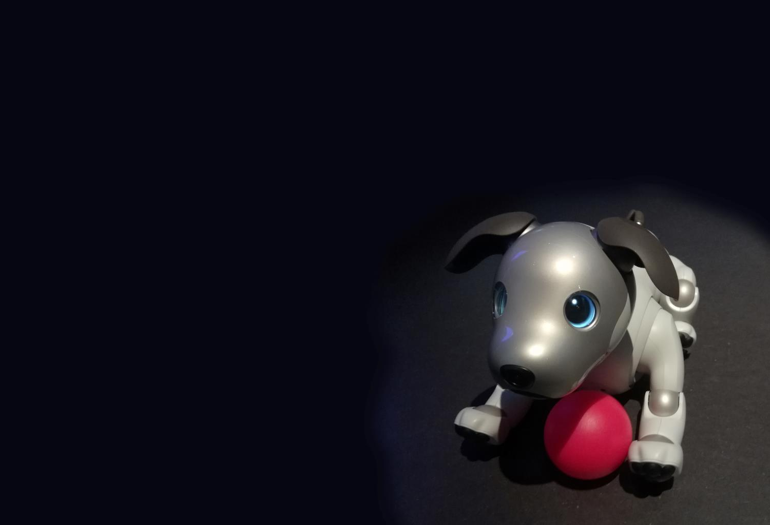
Robots in entertainment
Robot toys mimic animals and pets
The dog shown is Aibo
It has camera sensors on its nose and above its tail
Other sensors detect stroking
Actuators control legs and movement
It has facial recognition and interacts differently with each person it plays with

Slide 18
Worksheet 2
Complete Task 3 on Worksheet 2

Slide 19
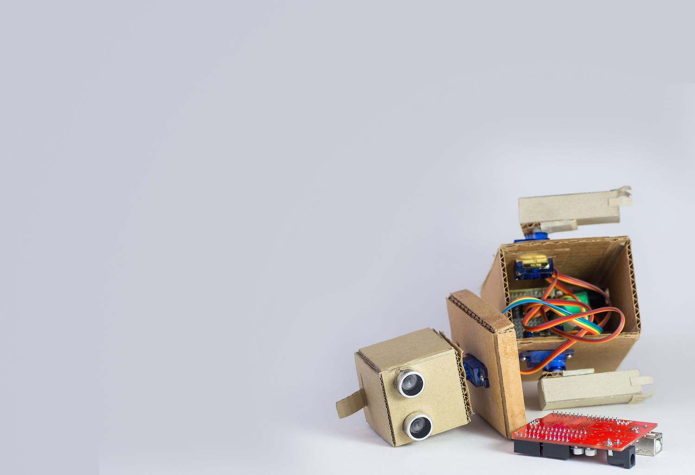
Advantages and disadvantages
Choose one robot used in industry, agriculture, medicine or entertainment
Create a list of advantages and disadvantages for the robot you have chosen

Slide 20
Advantages
The advantages and disadvantages will be different for every robot, but common advantages include:
Reduces the cost / need for humans to do the task
Works faster
Is more accurate / efficient
Is able to work in dangerous environments / reduces the risks to humans
Is able to work 24 x 7 / works without a break

Slide 21
Disadvantages
Disadvantages may include:
The cost of purchasing the robot (or replacing it if it breaks)
The robot being unreliable / less reliable than a human
The robot not doing as good a job as a human
Jobs being lost as a result of the robot
A loss of contact with real people

Slide 22
Worksheet 2
Complete Task 4 on Worksheet 2

Slide 23

Plenary
Describe three characteristics of robots
Give two advantages and two disadvantages of using robots as company for lonely elderly people

Slide 24
Plenary
Three characteristics of robots
A mechanical structure or framework
Electrical components, such as sensors, microprocessors and actuators
Programmable
Examples of advantages and disadvantages
+ Work 24 hours a day without breaks; + If programmed correctly, can be highly accurate and give consistent results; cheaper than employing humans
- Not as good as humans; - people lose touch with real human contact and may still feel lonely

